Slide 1
FAMOUS PEOPLE
Учитель английского языка
Cикалова Галина Николаевна
МБОУ СОШ №28 ст. Тамань

Slide 2
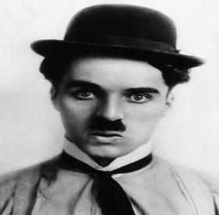
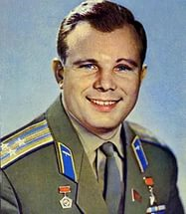
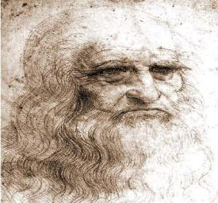
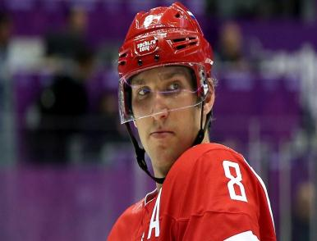
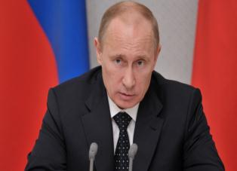
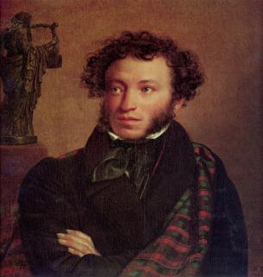
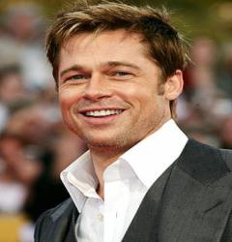

Slide 3
Match the famous people with their jobs.
1/ Anna Pavlova a/ dancer
2/ Marie and Pierre Curie b/ artist
3/ Brad Pitt and Angelina Jolie c/ inventor
4/ J. K. Rowling d/writer
5/ Leonardo da Vinci e/ scientist
6/ Nicola Tesla f/ actor
7/ Dima Bilan g/ singer

Slide 4
to be

Slide 5
to be

Slide 7
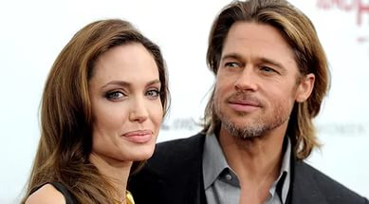
Brad Pitt and Angelina Jolie are actors

Slide 8
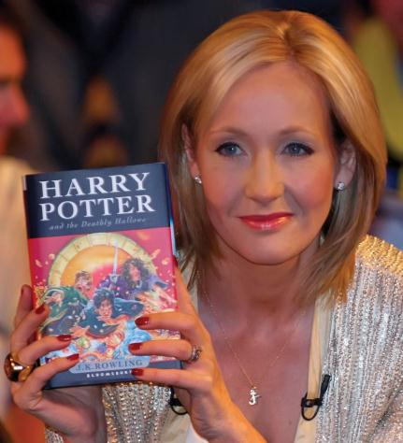
J. K. Rowling is a writer

Slide 9
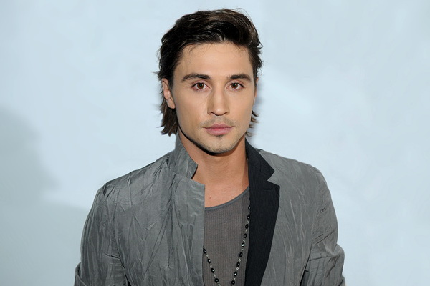
Dima Bilan is a singer.

Slide 10
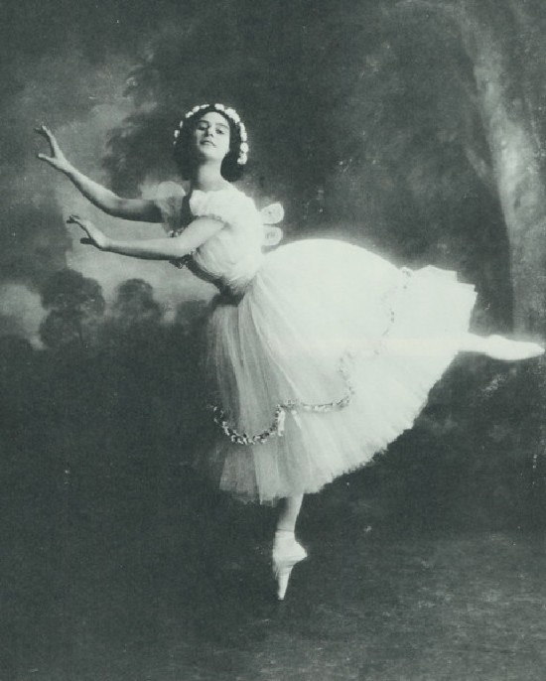
Anna Pavlova was a dancer.

Slide 11
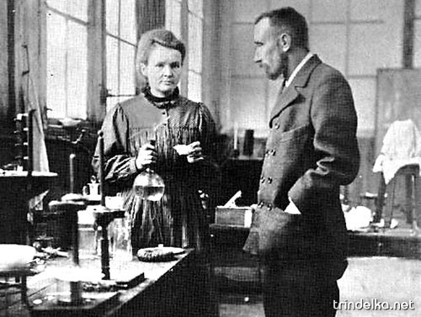
Marie and Pierre Curie were inventors

Slide 12
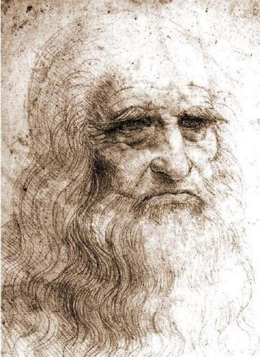
Leonardo da Vinci was an artist

Slide 13
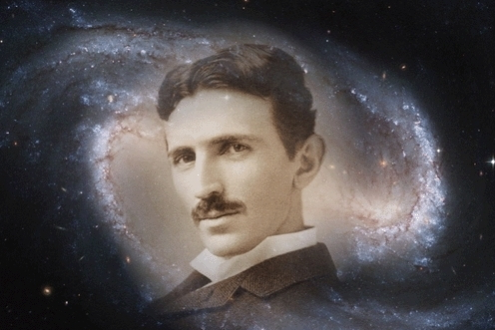
Nicola Tesla was an inventor

Slide 14
9-10-5 5-3-3 8-6-4 2-1-2
1. художник
2. танцор
3. изобретатель
4. писатель
5. учёный
6. известный
7. were
8. was
9. в единственном
10. во множественном

Slide 15
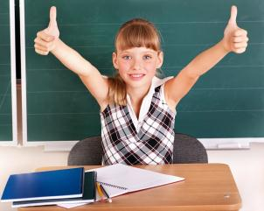
Рефлексия
Чтобы достичь цели, надо, прежде всего, к ней идти!
That’s why I should:
* be attentive, emotional, active;
* listen to my classmates, to my teacher;
* ask and answer different questions;
* participate in discussion;
* review some words and grammar rules;
* read a lot;
* open the book at page….

Slide 16
Thank you for attention

